Slide 1
Module 7: Lesson 1 Using Databases for Big Data Storage

Slide 2
Big Data Storage Technology Limitations
To this point we have only explored two forms of storage technology appropriate for use in working with big data: object storage (S3) and distributed file storage (HDFS)
But as useful are these technologies are they both have critical limitations which negatively impact our ability to effectively ingest, store and process big data
HDFS and S3 primarily store data in immutable files. While some limited update capabilities may exist (appending), they are not efficient for frequently changing data.
S3 and HDFS do not support reading/selecting, inserting, updating or deleting individual data records, for which additional tools (Hive, HBase) are required
While S3 and HDFS can store various data formats, they lack the built-in support for metadata or data validation

Slide 3
What About Traditional Relational Databases? Benefits
Record Level Operations
Supports creation, reading, updating and deletion of individual records
Relational Model
Organizes data in tables with rows and columns, enforcing relationships between them using primary and foreign keys to ensure data consistency and efficient retrieval.
Query Language
Uses SQL, a standardized query language that offers expressive capabilities, allowing users to retrieve data precisely using conditional statements, filtering based on specific criteria, and joining data across multiple tables
ACID Compliance
Excels in situations requiring strict data consistency and transactional integrity (both within and across tables), by offering ACID properties (Atomicity, Consistency, Isolation, Durability).
Maturity
Relational database technology has been around for decades, making it a mature and stable solution. Familiarity and expertise in SQL is widespread among data professionals.

Slide 4
What About Traditional Relational Databases? Drawbacks
Schema Rigidity
SQL databases enforce rigid schema requirements, which can pose challenges when dealing with unstructured or semi-structured data commonly encountered in big data scenarios
Limited Vertical Scalability
Vertical scaling becomes expensive and inefficient as data volume grows exponentially.
Limited Horizontal Scalability
Relational databases heavily rely on joins to combine data from multiple tables for complex queries. In a horizontally scaled environment, these joins become complex as data is spread across different servers. Horizontal scalability is uncommon, functionally limited, very expensive, and administratively complex.
Performance Degradation
As data volume increases, relational databases experience performance degradation, especially during complex queries or joins, due to the need to scan through large datasets, process numerous records, and move data across the network
Concurrency Issues
High volumes of concurrent reads and writes associated with big data can overwhelm traditional relational database architectures, leading to reduced performance
Complex Failover Mechanisms
Implementing failover mechanisms in case of server failure can be intricate. Setting up and maintaining a standby server with synchronized data adds complexity and ongoing management overhead.

Slide 5
From Relational Databases to Big Data Alternatives
Relational Database Systems
The Challenges of Big Data
Distributed Systems Technology
Parallel Processing Systems
Parallel Execution Systems (MapReduce, Spark)
Distributed Database Systems
NewSQL Database Systems
NoSQL Database Systems
Distributed File Systems
Limitations of Relational Systems and Data Model

Slide 6
Distributed Database Systems
A collection of interconnected nodes or servers that collaboratively store and manage data across multiple geographic locations or computing environments.
Functions as a single logical entity. Users interact with the database as a whole, unaware of the underlying distribution
Offer scalability by allowing seamless addition or removal of nodes to accommodate growing data volumes and workloads, enhancing performance and responsiveness.
By replicating data across multiple nodes, offers fault tolerance. If one node fails, another can take over, ensuring continuous operation and data accessibility
Manages data consistency across nodes, handling node failures, and optimizing query execution for distributed storage.

Slide 7
NewSQL Database Systems
Databases offering enhanced performance and parallel processing for big data workloads while maintaining SQL compatibility
Designed for the cloud environment, allowing for horizontal scaling of resources where users can easily add or remove virtual machines based on processing needs
Data is distributed across multiple nodes which significantly improves performance for large datasets and complex queries compared to traditional relational databases.
Supports querying data using familiar SQL syntax. This makes it easier for existing SQL users to transition to these systems and leverage their existing knowledge.
Maintains strong data consistency (ACID transactions) ensuring data integrity for critical operations, similar to traditional relational databases.

Slide 8
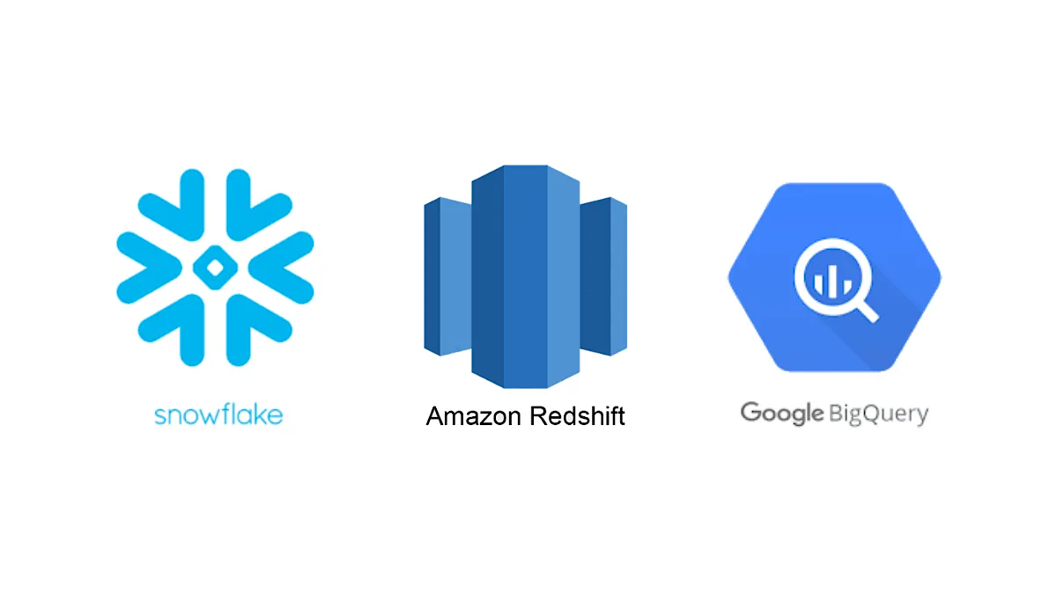
NewSQL Database Systems

Slide 9
NewSQL Database Systems Challenges
Write performance can be a challenge in NewSQL databases. While these databases are designed for high read performance, they can struggle with write-heavy workloads
Maintaining ACID compliance (especially Atomicity and Durability) in a distributed environment can introduce overhead compared to traditional databases.
Supports a structured data model similar to traditional relational databases which might not be ideal for the unstructured data encountered in some big data scenarios.
New SQL databases may face limitations when dealing with highly complex queries, especially involving joins, potentially leading to performance issues

Slide 10
NoSQL Database Systems
Not Only SQL
No standard or generally agreed on definition of what NoSQL means
The SQL (relational database) scalability issue was recognized by companies with huge, growing data management needs, such as Google, Amazon, and Facebook.
So they developed distributed databases that store data in a format other than relational tables and use query languages other than ANSI standard SQL
These databases were optimized for handling big data and real-time analytics workloads, offering efficient data ingestion (writes), processing, and retrieval (reads)
Pragmatic business concerns let to a variety of NoSQL database that support diverse data models, including key-value, document, table, and graph.
Most NoSQL databases provide flexible query interfaces, often based on APIs or specialized (non ANSI SQL) query languages tailored to specific data models.

Slide 11
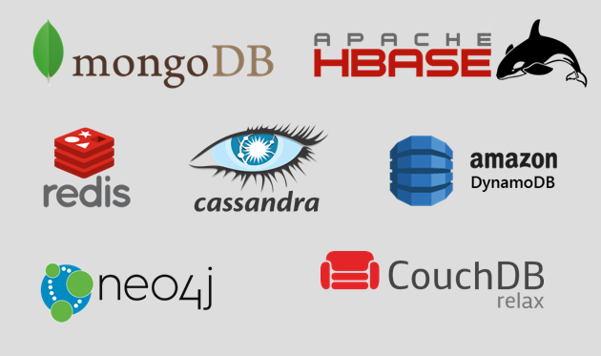
NoSQL Database Systems

Slide 12
NoSQL Database Uses – General
Real-Time Data Processing
Large-Scale Social Media Data
Internet of Things (IoT) Applications
Mobile App Backends
Recommendation Engines
Geospatial Data Management
Log and Event Management
Big Data Analytics Pipelines

Slide 13
NoSQL Database Uses Amazon Prime Day
Amazon DynamoDB is a fully managed NoSQL database service that provides fast and predictable performance with seamless scalability.
DynamoDB powers multiple high-traffic Amazon properties and systems including Alexa, the Amazon.com sites, and all Amazon fulfillment centers.
Over the course of Prime Day, these sources made trillions of calls to the DynamoDB API.
DynamoDB maintained high availability while delivering single-digit millisecond responses and peaking at 126 million requests per second.

Slide 14
NoSQL Database Uses Amazon Ads
Amazon Ads Measurement provides metrics that helps advertisers better understand the return on their advertising spend
It uses DynamoDB to process more than 100B events and store over 4 petabytes of data
It supports peak traffic during events like Thursday Night Football and Prime Day reaching 90 million reads and 5 million writes per second
By migrating this service to DynamoDB, Amazon Ads increased its service availability to 99.999% taking advantage of data replication and redundant virtual machines

Slide 15
NoSQL Database Uses Lambda Architecture Support
Serving Layer | NoSQL databases enable efficient retrieval of processed data from both the speed and batch layers, providing fast access to real-time and historical insights for serving queries, reports, or interactive applications.
Speed Layer | NoSQL databases facilitate rapid ingestion of streaming data from various sources, such as sensors, social media feeds, or transaction logs NoSQL databases provide low-latency access to incoming data, allowing the speed layer to quickly store, query, and update data in response to dynamic events
Batch Layer | NoSQL databases seamlessly integrate with the batch layer of the Lambda architecture, providing a unified platform for storing and processing both real-time and historical data. This integration enables holistic data analysis and enables the architecture to generate comprehensive insights by combining real-time and batch processing results.

Slide 16
NoSQL Database Systems Challenges
Not Only SQL → No (or Limited) Joins; No (or Limited) ACID Semantics
Limited support for combining data residing across multiple tables or similar groupings
Traditional join algorithms designed for centralized databases become inefficient in a distributed setting due to the cost of data movement across the network.
NoSQL databases use alternatives such as denormalization, document embedding, or specialized lookup operations in place of joins
Optimizing query execution plans to minimize data movement and leverage local processing power on each node is crucial for maintaining performance.

Slide 17
NoSQL Database Systems Challenges
Data replication, where copies of data are stored on multiple nodes, enhances availability and fault tolerance. But, maintaining consistency across replicas after updates presents a complex issue.
Distributed systems are inherently susceptible to network delays and potential network partitions. These can hinder data availability and impede timely updates across nodes.
Designing effective partitioning strategies to distribute data across multiple nodes while minimizing data skew and hotspots is a complex endeavor.
Enabling concurrent access to shared data in a distributed environment introduces challenges related to concurrency control and transaction management
Serializability, ensuring a single execution order for concurrent transactions across geographically dispersed nodes, is difficult to achieve.

